Slide 1
IoT Special Topic IV: Indoor Positioning System (IPS) & Location-Based Service (LBS)
Group 6

Slide 2
Algorithm
Log-Distance Path-Loss Model
Kalman Filter
Positioning
Algorithm Explained
System Flowchart
Experiment
Data Processing
Discussion

Slide 3
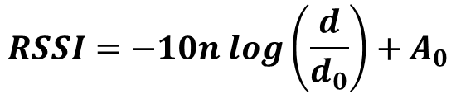

Algorithm
Indoor Positioning based on RSSI
Log-Distance Path-Loss Model
$$RSSI=−10n log\left(\frac{d}{d_{0}}\right)+A_{0}$$
Kalman Filter
$$x_{t}=A_{t}x_{t−1}+B_{t}u_{t}+ε_{t}≈x_{t−1}+ε_{t}$$
Positioning
$$Ax=B$$

Slide 4
Algorithm Explained
RSSI is measured in dBm . We can translate the measurements to distance estimates in meters. More precise, we can describe the relation between RSSI and distance using Log-Distance Path-Loss Model.
But our estimates are still not very good ( RSSI values are heavily influenced by the environment and have, consequently, high levels of noise )
The regular Kalman filter assumes linear models. That is, the step from the current state to the next state, and the translation from state to measurement should be linear transformations. We can assume that the error of state follows the Gaussian Distribution. ( But we think it is not the truth in this room ~ )

Slide 5

System Flowchart
AP1
RSSI
Kalman Filter
AP2
Remove noise
RPi
Data
Server
Path-Loss Model
AP3
Get Distance
$$Ax=B$$
AP4
Result

Slide 6
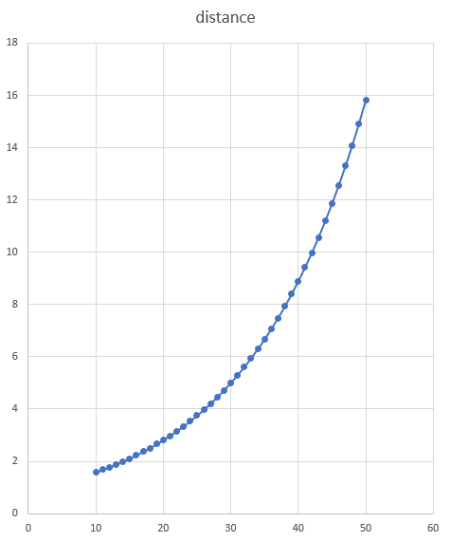
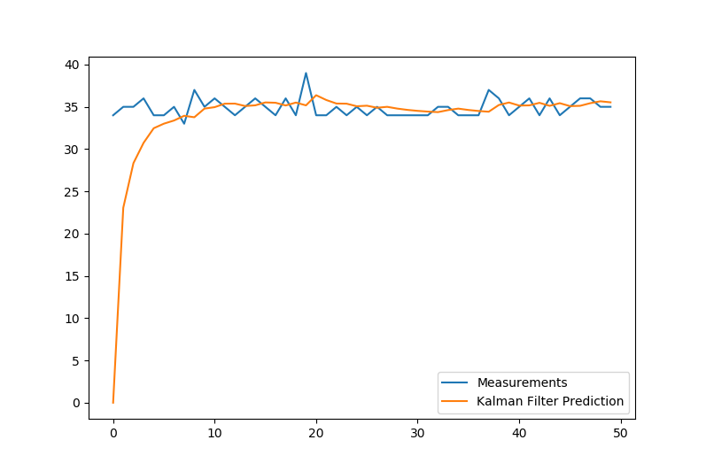
Experiment
Figure 1. Kalman Filter
Figure 2. Distance Measurements

Slide 7
Discussion
Indoor Positioning based on RSSI may not be a good method to measure the location. The accuracy of the RSSI measurement is hard to regulate, which means though we use filter to remove the noise, we just remove the noise from a noise.
Using filter need times to receive data.
Parameters of the Path-Loss Model are hard to be regulated.

